Slide 1
Automate Your Network
Introducing the Modern Approach to Enterprise Network Management
John Capobianco
Sr. IT Planner and Integrator – Canadian House of Commons

Slide 2
Introduction
Who am I?
A Network Engineer turned Developer
Computer Programmer Analyst – St. Lawrence College (2000-2003)
Client / Server – 2000 – 2008 (A+, Network +, MCITP: EA/SA; ITIL)
Networks – 2008 – present (CCNA, CCNP, CCNP:DC, 5x Cisco Specialist)
Professor CNTS Program – St. Lawrence College (2010-2013) Joined the House of Commons 2013 – “NG-PPN”
According to my e-mail archives I first became aware of Ansible in April 2017
2

Slide 3
Introduction
What have I automated?
Everything!
Cisco: Catalyst 2960 / 3560 / 3750 / 3850 / 4500 / 6500 / 9300 Nexus 9K / 7K / 5K / FEX Integrated Services Routers 891FW / 4400 FXOS / ASA Identity Services Engine Prime Infrastructure Umbrella Cisco.com APIs | Servers: Red Hat Enterprise CentOS Microsoft Windows Servers VMWare Clouds: Azure AzureStack | Storage: Solidfire Appliances: F5 BIGIP Forcepoint NGFW Gigamon
3

Slide 4
Introduction
What are my challenges?
Why did I turn to Ansible?
Ever growing complexity !
From VRFs to clouds to BGP to OSPF to 802.1x to Netflow to STP
Consistency at scale
How to ensure hundreds / thousands of devices and their interfaces are correctly configured to a corporate standard at scale
How do I know the network is functional
Agility
How to rise to the challenge of ever increasing demand for network services
Human operational limitations
My general workflow of submitting changes to be manually implemented by humans was becoming exceeding difficult
4

Slide 5
Introduction
Why Ansible?
It’s not just another new tool
Simple | Powerful | Agentless
Human readable automation No special coding skills needed Tasks executed serially Usable by every team Get productive quickly | App deployment Configuration management Workflow orchestration Network automation Orchestrate the app lifecycle | Agentless architecture OpenSSH, WinRM, and HTTPS No agents to exploit or update Get started immediately More efficient & more secure
5

Slide 6
Introduction
Introduction to Ansible
What is Ansible ?
Why you should use Ansible ?
The basics of Ansible
6

Slide 7
Introduction
What is Ansible?
It is *NOT* C++ for Networks !
The Ansible project is an open source community sponsored by Red Hat. It’s also a simple automation framework that describes infrastructure in Ansible playbooks.
Under the hood Ansible is Python code, but this is abstracted You do NOT need to be a software developer or programmer analyst
It's an automation engine that runs Ansible playbooks. Not a programing language!
7

Slide 8
Introduction
The Ansible Advantage
CROSS PLATFORM – Linux, Windows, UNIX Agentless support for all major OS variants, physical, virtual, cloud and network devices
HUMAN READABLE – YAML Perfectly describe and document every aspect of your application environment
PERFECT DESCRIPTION OF APPLICATION Every change can be made by playbooks, ensuring everyone is on the same page
VERSION CONTROLLED Playbooks are plain-text. Treat them like code in your existing version control.
STATIC OR DYNAMIC INVENTORIES Capture all the servers 100% of the time, regardless of infrastructure, location, etc.
ORCHESTRATION THAT PLAYS WELL WITH OTHERS Homogenize existing environments by leveraging current toolsets and update mechanisms.
8

Slide 9
Introduction
Why Automation is Important
Not in the future – in the present!
Your networks, services, and applications are more than just collections of configurations. They’re a finely tuned and ordered list of tasks and processes that result in your working application.
Ansible can do it all:
Provisioning
App Deployment
Configuration Management
Multi-tier Orchestration
Documentation
On-Prem or Clouds
9

Slide 10
Introduction
Use Case Examples
Some ideas to get you thinking
Configuration Management: Centralizing configuration file management and deployment Security and Compliance: Auditing and remediation and integrate into automated processes Continuous Delivery: Keep your applications properly deployed throughout their entire lifecycle Provisioning: Helps streamline the process whether your deploying on bare-metal or the cloud Feature deployment: Manage the entire feature lifecycle from development to production. | Orchestration: Bring multiple configurations together and manage them as a whole Network Automation: device provisioning, performing compliance checks, validate network topology, upgrading software. Updating Systems Documentation & Reporting: Created documentation derived from your code, create reports on multiple systems in a variety of formats.
10

Slide 11
Introduction
How Does Ansible Work?
Inventory – ini file or dynamic: Contains hosts & group information Playbooks - YAML with imbedded Jinja: Tasks executed sequentially, Invokes Modules Ansible tools: Plays, Tasks, loops, Handlers, Blocks, Tags, Check mode Templates - jinja to generate: Configuration files Documentation (markdown/html) Plugins – Python: Codes the plugs into the core engine Adaptability for various uses and platforms Modules – Python & PowerShell: Tools in the toolkit, extend simplicity to entire stack Can be any language that returns json
11

Slide 12
Introduction
Key Ansible Features
Idempotency:
The ability to run an operation which produces the same result whether run once or multiple times
Check-mode:
validate your code before actually making the change, build confidence!
Diff-Mode:
Some modules support diff mode, use in combination with check-mode to review before applying change!
Limit:
Dynamically, at run time, adjust the scope of your playbook
12

Slide 13
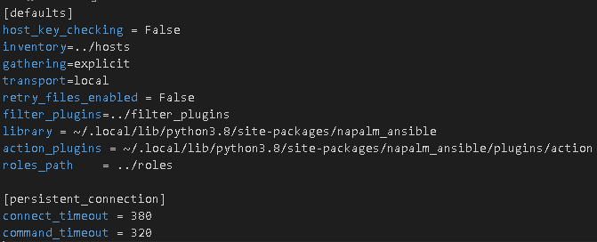
Introduction
Ansible.cfg
Within the same folder as your Ansible playbooks there is an Ansible.cfg file Certain settings in Ansible are adjustable via a configuration file (ansible.cfg). The stock configuration should be sufficient for most users, but there may be reasons you would want to change them. Here you set paths to certain folders; set environment variables; and add additional options and features
13

Slide 14
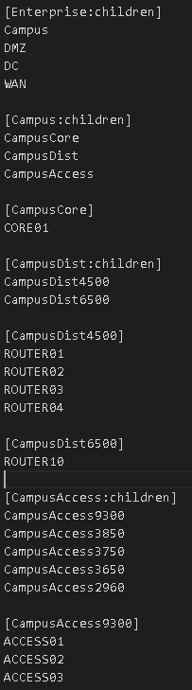
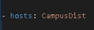
Introduction
Inventory - hosts
Ansible uses a hosts file to identify targets and scope of playbooks hosts can be static or dynamic from an upstream source of truth (IPAM, inventory system, etc) hosts can be organized into logical hierarchies, grouped by platform, function, or role; geographic, campus, data center, or cloud location Custom groups of hosts can be created to identify the scope of a specific playbook Completely flexible
14

Slide 15
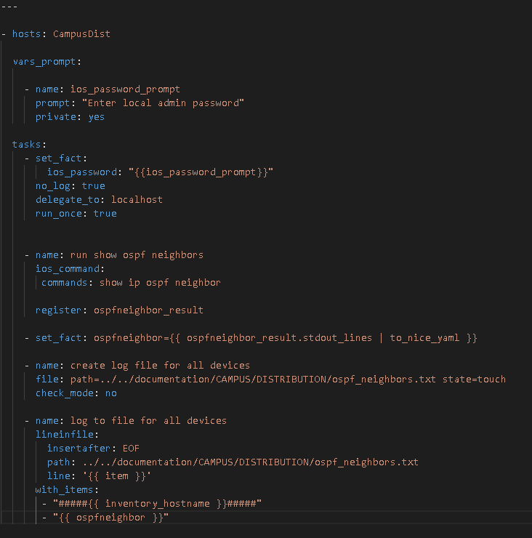
Introduction
Ansible Playbooks
YAML Ain't Markup Language (YAML) Human-readable Simple or complex Serially executed Can be interactive (prompted input) Scope based on inventory (hosts) file
15

Slide 16
The Modern Enterprise Network Management Toolkit
The Modern Enterprise Network Management Toolkit
Introducing the toolkit to maximize your productivity and chance of success
Brief introduction and overview of the key components
16

Slide 17
The Modern Enterprise Network Management Toolkit
Toolkit – A Journey
Learn from my mistakes!
My first playbook
Written in Notepad on my Windows workstation
Transferred to Linux host with Ansible with WinSCP
Back and forth trial and error (with emphasis on error)
Eventually had “success” but I was clearly missing the big picture
There had to be a better way
Enter the Modern Enterprise Network Management Toolkit
17

Slide 18
The Automation Progression Pyramid
CI/CD
Full Configuration Management
State Validation
Tactical Changes 1 Time Playbooks
Capture Network State Gather Information
Establish Connectivity
Build Toolkit
18

Slide 19

The Modern Enterprise Network Management Toolkit
19

Slide 20
The Modern Enterprise Network Management Toolkit
A Standard (Legacy) Toolkit
Old tools for old methodologies
A text editor, possibly “enhanced”
A console cable (or VTY port)
Putty
A file transfer, or several, program (FTP / SFTP / SCP / TFTP)
RAW CLI output gathered device-by-device
20

Slide 21
The Modern Enterprise Network Management Toolkit
Infrastructure As Code
This revolution and evolution allows traditional system administrators and engineers work with code like a developer!
Accepting software development lifecycle practices are vital because automation isn’t about building a button to press when its time.
Instead, create an automation framework that adjusts the infrastructure to your definition of it.
Changing the code changes the infrastructure not pushing a button you built
21

Slide 22
The Modern Enterprise Network Management Toolkit
A Modern Toolkit’s Components
Linux Ansible and Ansible Modules Ansible Tower Git GitHub Microsoft Team Foundation Server (TFS) / AzureDevOps Visual Studio Code VS Code Extensions APIs cURL Postman Ansible URI Module RegEx | YAML Jinja2 Python Markdown CSV Mind Maps pyATS Genie Parsers Docker JSON XML HTML
22

Slide 23
The Modern Enterprise Network Management Toolkit
Linux
Open, typically CLI driven, Operating System Several flavors including licensed and supported Red Hat Enterprise License (RHEL) versions or free versions like CentOS Required to host your Ansible environment Playbooks executed from Linux host To install Ansible on RHEL or CentOS: sudo yum install ansible | ** Linux host requires access to the network’s management plane ** Should be secure May require firewall permissions to reach targets
23

Slide 24
The Modern Enterprise Network Management Toolkit
Ansible Modules
Ansible supports all different kinds of devices with specific modules and anything with a REST API ! Look up the platform and find the available modules There are specific modules for, example, banner or NTP, or more generic command and config modules Some modules accept templates as the source of input (more on templates later) | Cisco: ios command: Performs IOS commands on Catalyst devices in privileged exec mode Ios config: Performs IOS commands in configuration modes nxos command nxos config asa command asa config
24

Slide 25
The Modern Enterprise Network Management Toolkit
Git
Since we are now working with code – we need a version and source control system. Enter: Git
Git is a distributed version control system, meaning your local copy of code is a complete version control repository.
Git tracks changes and uses internal mechanisms such as commits and pull requests to merge changes back into main
25

Slide 26
The Modern Enterprise Network Management Toolkit
Git Branching
You will need to develop a branching strategy as a core component of Git is branches
The main branch, which represents valid, tested, known-good code, should be protected from direct changes
Any changes required, such as a new feature, new device, bug fix, or enhancement should be done under a working branch
26

Slide 27
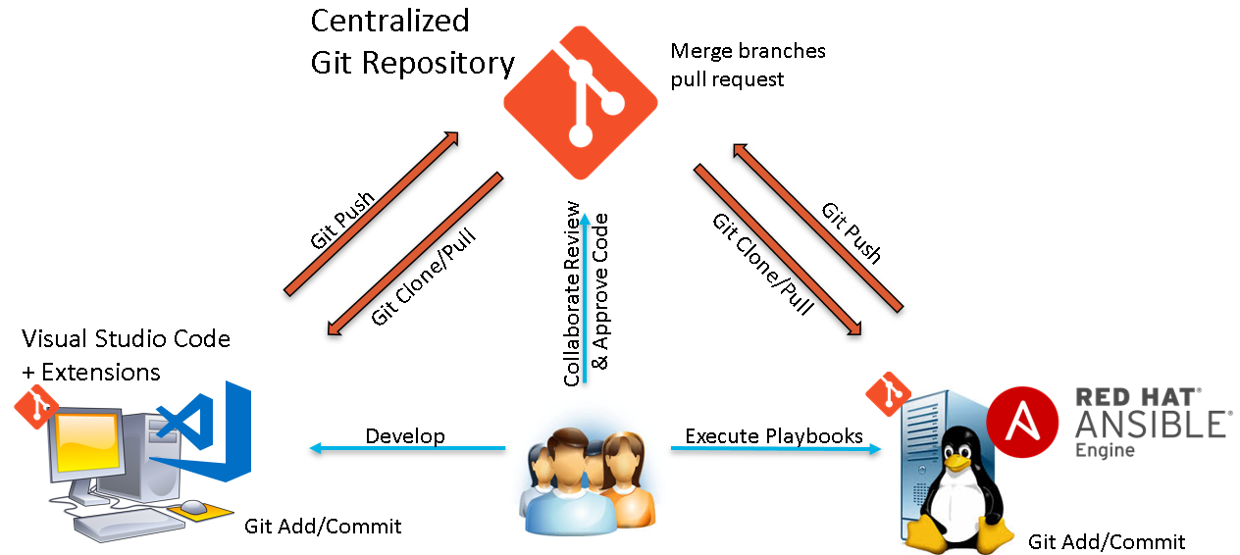
The Modern Enterprise Network Management Toolkit
Git Branching
27

Slide 28
The Modern Enterprise Network Management Toolkit
Git Repositories
GitHub is the most famous example
Be very careful with what you store in GitHub repositories if they are public !
SSH keys, device secrets, public IP addresses, DNS records; many things should be handled with the utmost care.
There are private enterprise grade systems like Microsoft TFS or Azure Dev Ops to safely store Git repositories privately to your organization and secured behind RBAC and Kerberos controls.
28

Slide 29
The Modern Enterprise Network Management Toolkit
Common Git Operations
git clone: Clone a Git repository locally either to your development system, likely Windows, using VS Code, or into your Ansible host using the Linux CLI
git pull: Refresh your local copy from the central repository to pull down any upstream changes
git add: Stage local changes to be committed
git commit: Commit local changes to the local repository
git push: Push locally committed changes into the central repository
Pull request: Pull changes from a branch into another branch, typically main
29

Slide 30
The Modern Enterprise Network Management Toolkit
Visual Studio Code
VS Code blurs the lines between a powerful text editor and a full blown IDE and makes creating Ansible-related files much simpler
A vast library of powerful extensions further add to the power and native capabilities
Fully Git integrated and aware
New Live Share capabilities allow for teams to write code together sharing the editing space collaboratively with audio and whiteboard integrations
30

Slide 31
The Modern Enterprise Network Management Toolkit
VS Code Extensions
Ansible Better Jinja Chat Excel Viewer Git (integrated at OS level) Git Graph Git Lens Live Share Live Share Audio | Markdown Preview Enhanced Markdown Lint Open in Default Browser Peacock PowerShell Python Various Themes VS Code Icons YAML
31

Slide 32
The Modern Enterprise Network Management Toolkit
Application Programming Interface (API)
An API is a web-service that provides the ability to interact with a system using structured data.
You can retrieve stateful information using a representational state transfer
(REST) API using a GET command.
Records can be added using a POST and updated using a PUT (which is idempotent)
32

Slide 33
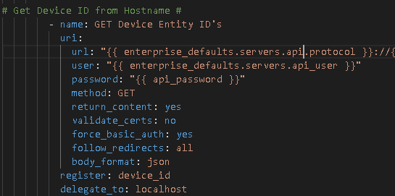
The Modern Enterprise Network Management Toolkit
Automating APIs
Traditionally APIs were interfaced with using cURL at the CLI.
A GUI client called Postman was released in 2012.
Postman or cURL can be used to validate an API call, or string, and then the API activity can be automated with the Ansible URI module
33

Slide 34
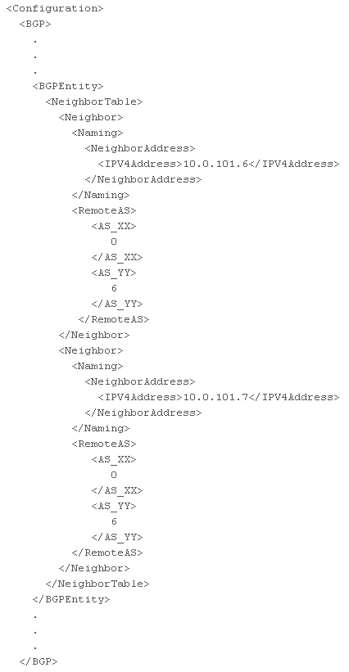
The Modern Enterprise Network Management Toolkit
eXtensible Markup Language (XML)
A common form of structured data an API often returns is in XML format Extensible Markup Language (XML) is a markup language that defines a set of rules for encoding documents in a format that is both human-readable and machine-readable XML can be challenging to work with Some legacy APIs only return XML
34

Slide 35
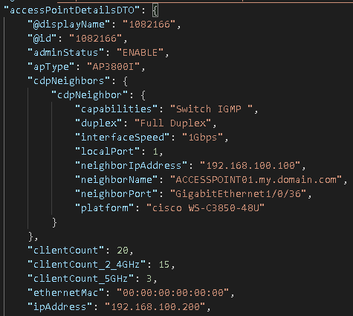
The Modern Enterprise Network Management Toolkit
JavaScript Object Notation (JSON)
JSON (JavaScript Object Notation) is a lightweight data-interchange format. It is easy for humans to read and write. It is easy for machines to parse and generate JSON is often preferred to XML Ansible can use json query functions to do SQL-like lookups against JSON data
35

Slide 36
Introduction
More on YAML
What is YAML :
A human-readable data serialization language for all programing languages
Similar to XML and JSON, but way easier to read and write
It is line-oriented, therefore makes it easier to compare / diff (useful when reviewing code / pull request)
36

Slide 37
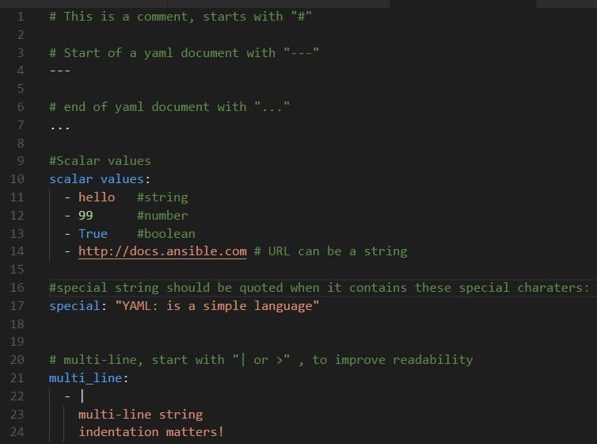
Introduction
YAML Syntax
Get to know the rules
Indentation matters: spaces only, no tabs allowed Comments start with “#” Start of document with “---” End of document with “…” (optional) Scalar values: string, number, Boolean Special Character need to be quoted “”: (:, {, }, [, ], ,, &, *, #, ?, |, -, <, >, =, !, %, @, underscore) Multi-line, start with “|” or “>”, improves readability – must be indented under |
37

Slide 38
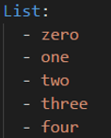
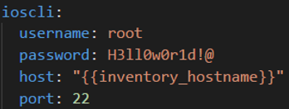
Introduction
Lists and Key-Pair Values
The building blocks
LISTS Ordered collection of values also know as sequences in YAML Accessed by absolute position of an item (zero based in YAML) Each value could be a simple value, list, object. One item per line Every line start with a dash “- “ Item value is the rest of the line Don’t use comments in-line, as they are treated differently by various parsers! Shorthand with bracket “[ ]” , but not as easy to read! | Key-Pair Values A dictionary also know as mappings in YAML is represented in a simple key: value form , The colon must be followed by a space “: “ It is accessed by the key content, and is not sorted! Values can be any scalar value: string, number, Boolean or It can also contain a complex list, variables Key should be valid python variable: ASCII letters, numbers, underscore) no dashes “-”
38

Slide 39
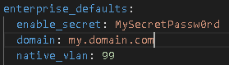
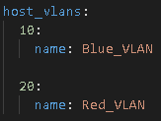
The Modern Enterprise Network Management Toolkit
More YAML!
Yes, more YAML! Along with Ansible playbooks you will eventually start to model your data in data models Data models are YAML files that contain key-pair values and lists that describe the intended configuration of an entity on a specific device, group of devices, or every device The values in the data model become variables available to the templates and can be used to generate configurations or documentation There are variables available at the group, role, and host level There are matching YAML files for the groups and hosts you add to the hosts file | An example of a group variable in a file called Enterprise.yml in the group vars folder An example of a host variable in a file called ROUTER01.yml in the host vars folder
39

Slide 40
The Modern Enterprise Network Management Toolkit
Jinja2
Templating language used by Ansible and Python
Use with Ansible Filter or Custom Filter
Delimiters:
{% ... %} for Statements
{{ ... }} for Expressions to print to the template output
{# ... #} for Comments not included in the template output
Syntax documentation: http://jinja.pocoo.org/docs/2.10/templates/
40

Slide 41
The Modern Enterprise Network Management Toolkit
Jinja2
Jinja templates will contain logic, such a If statements and For loops, and be simple or complex.
The variables in the templates reference group, role, and host data models that complete the template at playbook runtime
The output file generated by Ansible *must* match the *exact* syntax (CSV, markdown, IOS / NXOS, JSON, etc) of the file format being created
41

Slide 42
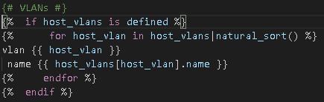
The Modern Enterprise Network Management Toolkit
Jinja2 – A Sample Template – Host VLANS
Index: Green text: Comments, not processed Pink text: Logic Light Blue text: Variables called from data models White text: Hardcoded text
42

Slide 43
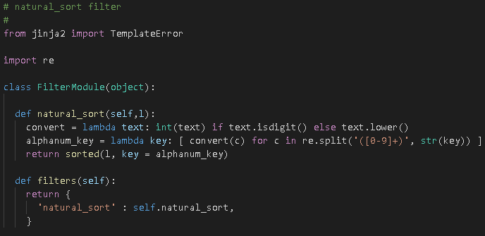
The Modern Enterprise Network Management Toolkit
Python
“Python is powerful... and fast; plays well with others; runs everywhere; is friendly & easy to learn; is Open.” Python's design philosophy emphasizes code readability Python is object-oriented You can write your own filters to enhance Ansible’s base functionality but you do NOT need to know Python to get started with Ansible | A custom natural sort filter written in Python that can be called in Ansible Referenced in Jinja2 template:
43

Slide 44
The Modern Enterprise Network Management Toolkit
HyperText Markup Language (HTML)
Most of us are familiar with consuming HTML, web pages, and browsers leaving creation of these pages to web developers
Jinja2 templates can be used to create interactive HTML pages based on your data models for quick and easy, and most importantly, automated documentation stored in your Git repository
So you might want to learn how to write your own HTML and create dynamic artifacts from your intent-based source of truth
44

Slide 45
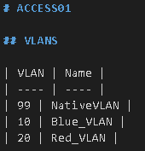
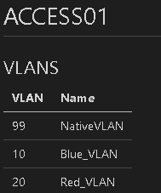
The Modern Enterprise Network Management Toolkit
Markdown
Markdown is a lightweight markup language with plain-text-formatting syntax Think of markdown as HTML-lite Despite it’s simplicity extremely powerful, automated, easy to read documents can be created, again, from Jinja templates sourcing data models (do you see a trend here?) | RAW markdown Rendered markdown
45

Slide 46
The Modern Enterprise Network Management Toolkit
Comma-Separated Values (CSV)
Like HTML, markdown, JSON, IOS / NXOS config, XML; powerful comma-separated value (CSV) files can be templated in Jinja2
These spreadsheets can be consumed upstream to create powerful artifacts in Excel or brought into systems like Power BI or other analytics
46

Slide 47
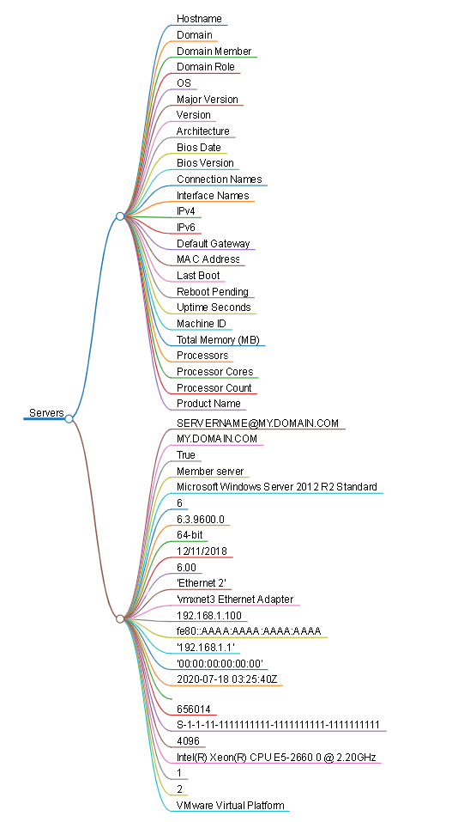
The Modern Enterprise Network Management Toolkit
Mind Maps
A relatively new format, known as a mind map, can be automatically generated from a valid markdown file A mind map is an interactive HTML page that creates keys and branches reflecting the data in a CSV-like format
47

Slide 48
The Modern Enterprise Network Management Toolkit
RegEx
Regular Expression, often referred to as RegEx, is a sequence of characters that define a search pattern
Meme from 1997: Some people, when confronted with a problem, think "I know, I'll use regular expressions." Now they have two problems
48

Slide 49
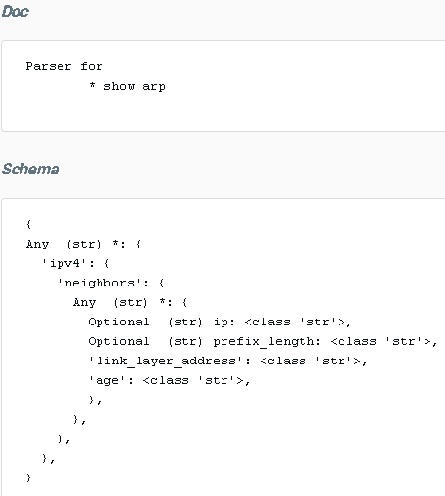
The Modern Enterprise Network Management Toolkit
Genie Parser
Parsing data has become easier, and integrated with Ansible, with Genie Genie returns structured data as opposed to raw command output As the returned data is JSON you can work with it like code instead of raw output
49

Slide 50
The Modern Enterprise Network Management Toolkit
pyATS
pyATS provides tests & verification automation
Ansible integrated to scale your testing
Works with YAML testbed files and Python tests
Provides real-time results from the perspective of the target host
50

Slide 51
The Automation Progression Pyramid
The Automation Progression Pyramid
Now that you have put together a modern toolkit – where and how do you start automating your network?
Personal reflection and more hard lessons learned
51

Slide 52
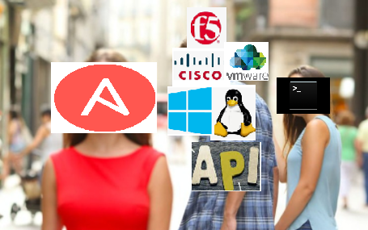
The Automation Progression Pyramid
52

Slide 53
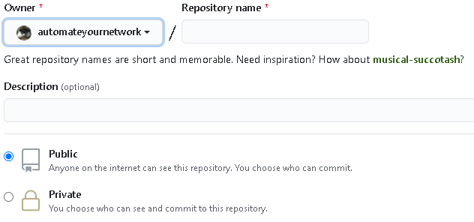
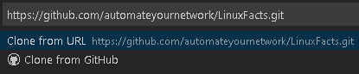
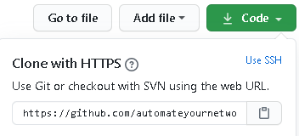
The Automation Progression Pyramid
Git Repository and Cloning your Repo
For this example we will use GitHub. Create an account and create a repository and initialize it with a README file Copy the link to your repository | Git clone the repository in your development workstation (likely Windows 10) where your VS Code installation resides, create a folder (C:repositories) and save the repository here Open the folder and begin to populate with your base folder structure
53

Slide 54
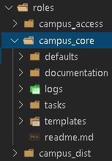
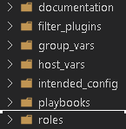
The Automation Progression Pyramid
Base Folder structure
Now that we have all our tools it’s time to take our first steps – a well organized based folder structure Some folders are required by Ansible while other folders, such as folders to store output or results, are arbitrary and discretionary Some folders you will need include: Group vars, host vars, roles, playbooks and filter plugins Your roles and playbooks folders should have a well organized sub-folder structure reflecting your logical environment In the sample structure documentation is an arbitrary folder to store formatted output while intended config stores the RAW IOS / NXOS / JSON configs being pushed to devices
54

Slide 55
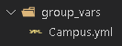
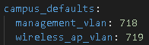
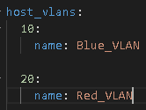

The Automation Progression Pyramid
Build Hosts file, Group Vars, Host Vars
Next we will add our hosts file I recommend you spend some quality time crafting your hierarchy but if your network follows a Core / Distribution / Access topology you could start here Remember your groups are in square brackets [ group ] If your group has sub-groups you add the children key [ group:children] This can nest down to an actual individual host These groups and hosts are then reflected in group and host vars folders and YAML files where we keep our intent in the form of variable-based data models | Hosts vars files data models
55

Slide 56
The Automation Progression Pyramid
CI/CD
Full Configuration Management
State Validation
Tactical Changes 1 Time Playbooks
Capture Network State Gather Information
Establish Connectivity
Build Toolkit
Establish secure connectivity to hosts
56

Slide 57
The Automation Progression Pyramid
Establish Connectivity
Reminder that your Linux host running Ansible requires network connectivity to your target hosts as well as your Git repository
Work with your IT Security and Network Connectivity teams to establish an RBAC controlled, highly secure, well monitored and logged host in a secure zone in your data centre You may need new credentials or service accounts to provide an authentication mechanism
57

Slide 58
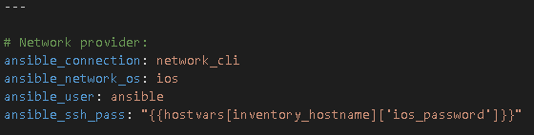
The Automation Progression Pyramid
Establish Connectivity
Ansible is agent-less and uses SSH, WinRM, or REST APIs to establish connectivity and the ability to resolve (DNS) the hosts There are various ways to authenticate against a device: Pass hard-coded credentials Prompt for input at runtime SSH keys | Here is an example of a connection string using a hard-coded username and a prompted password This is located in the group var or host var file This is using the network cli connection against a Cisco IOS device All devices in this group will use this mechanism to authenticate
58

Slide 59
The Automation Progression Pyramid
On Authentication
If you choose hard coded authentication strings be aware these are stored in the Git repository Ansible Vault can be used to encrypt your secrets so they are safe to store in your Git repo
You may need a service account
Prompted passwords are secure but do not lend themselves to full scheduled non-interactive automation
59

Slide 60
The Automation Progression Pyramid
CI/CD
Full Configuration Management
State Validation
Tactical Changes 1 Time Playbooks
Capture Network State Gather Information
Establish Connectivity
Build Toolkit
Ansible facts
Safe show commands
60

Slide 61
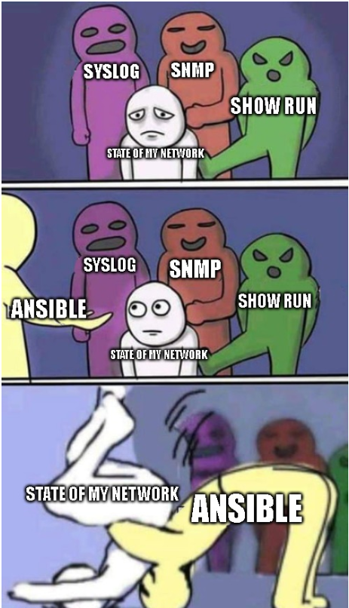
The Automation Progression Pyramid
61

Slide 62
The Automation Progression Pyramid
Your first playbook
We will start with gathering network state information or network configuration information gathering.
This approach has some benefits: It is safe – we are not configuring / changing / reloading / upgrading anything
It provides a baseline at scale
Begin building a dynamic library of facts and documentation about your network
Management not likely to baulk at this approach
62

Slide 63
The Automation Progression Pyramid
How to run a playbook
Running an Ansible playbook is a simply command: ansible-playbook <playbook.yml>
63

Slide 64
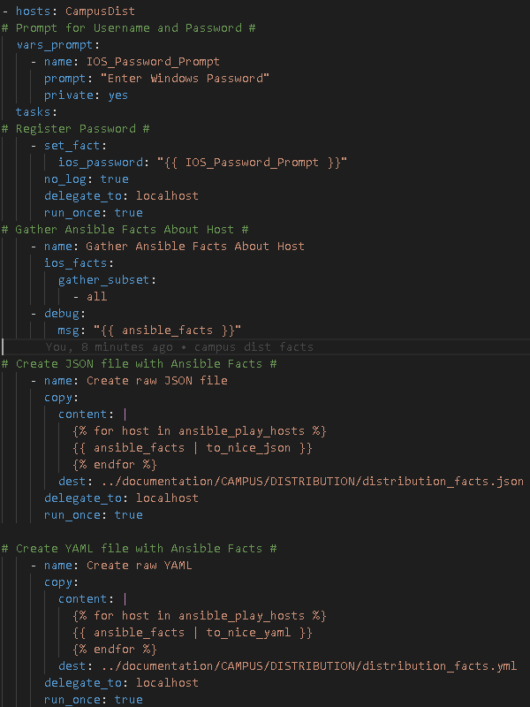
The Automation Progression Pyramid
Capture Current State / Gather Information
Ansible has the ability to gather facts from targeted host(s). Facts are useful, truthful, stateful variables with pieces of information about a host The setup module is used against Linux and Windows hosts while specific operating system facts modules exist for specific platforms like IOS, NXOS, F5, Azure, or VMWare All facts or subsets of facts can be specified to be gathered by the module | A sample playbook using ios facts
64

Slide 65
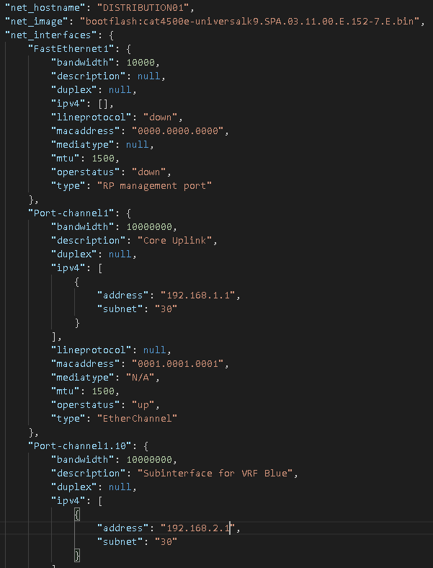
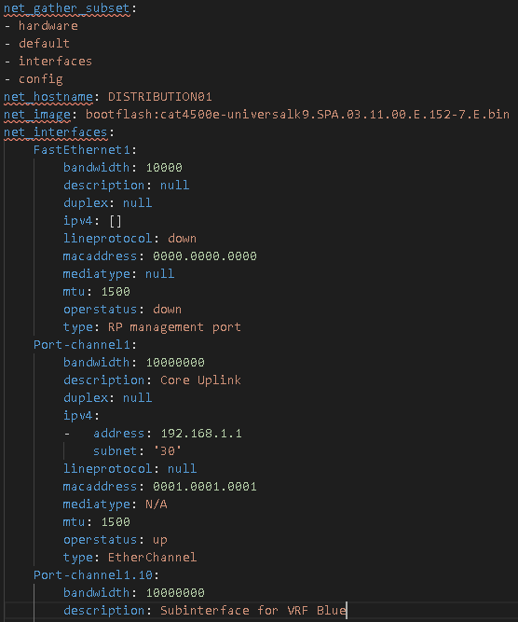
The Automation Progression Pyramid
Fact output
JSON | YAML
65

Slide 66
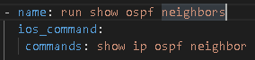
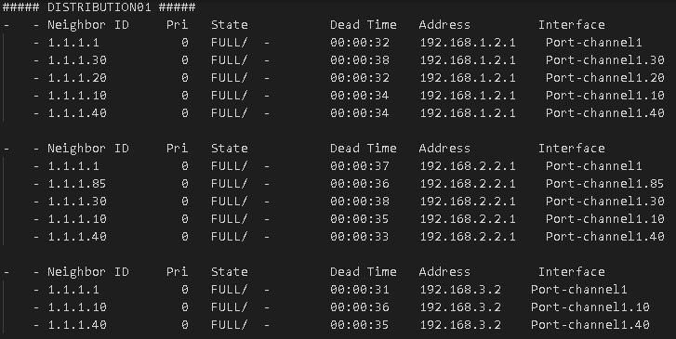
The Automation Progression Pyramid
Show commands
Modules like ios command and nxos command can be used to send privileged exec commands and send the output to text files Any command can be sent so use your imagination but here are some ideas: Show vlan sh ip arp sh mac address-table sh ip ospf neighbor sh ip bgp summary sh ip int brief sh int status sh int show spanning-tree sh spanning-tree blocked dir sh run sh start | Show ip ospf neighbors Output:
66

Slide 67
The Automation Progression Pyramid
CI/CD
Full Configuration Management
State Validation
Tactical Changes 1 Time Playbooks
Capture Network State Gather Information
Establish Connectivity
Build Toolkit
Tactical changes
1 time changes
67

Slide 68
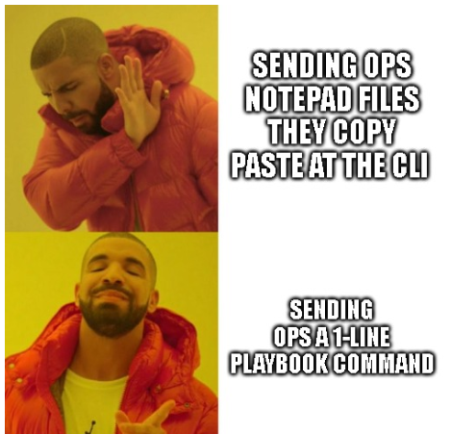
The Automation Progression Pyramid
68

Slide 69
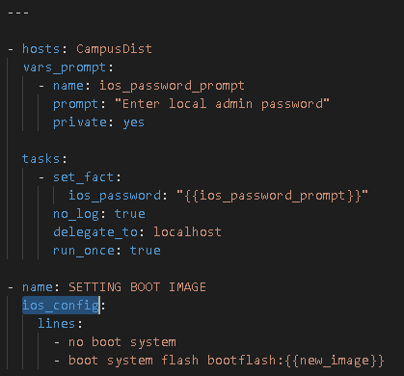
The Automation Progression Pyramid
Tactical / 1 Time Changes
Tactical (or 1 time) changes are playbooks with a specific set of orchestrated tasks to execute on one more many devices Generally speaking: Corporate standards Add / Remove / Set * Compliancy jobs vlans, vrfs, ntp New feature requests routes, ACLs Bug fixes / corrections “anything” Point-in-time changes | A sample ios config to clear and set the boot image variable on all devices at the Distribution layer
69

Slide 70
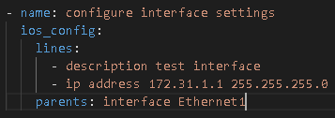
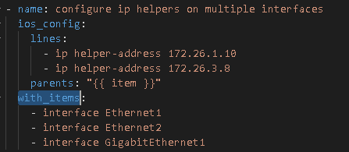
The Automation Progression Pyramid
Tactical / 1 Time Changes
Lines are executed serially ‘as-is’ Syntax is important Without parents the command is assumed to be issued at config terminal (conf t) level of a Cisco device Parents can be used to issue the commands from a sub-configuration mode such as interface, sub-interface, port-channel, RADIUS servers, etc Tasks can be orchestrated together serially in a pipelined automated chain with items, an Ansible loop mechanism, can be used in concert with parents to modify multiple elements in a single task | An example of parents adding an IP and description to a specific interface: An example adding ip helpers to multiple interfaces using with items
70

Slide 71
The Automation Progression Pyramid
CI/CD
Full Configuration Management
State Validation
Tactical Changes 1 Time Playbooks
Capture Network State Gather Information
Establish Connectivity
Build Toolkit
Full configuration management
71

Slide 72

The Automation Progression Pyramid
Data model: Your intended form
Template: The hammers making the shape
Raw metal: Your device
Playbook: Machine in motion
72

Slide 73
The Automation Progression Pyramid
Data Models
At the group level variables are shared by all downstream devices in the group and are common variables.
role level variables apply to all devices in that role
host level variables are unique and specific to that host
Enterprise (group) -> Campus(group) -> Campus Distribution (group) -> Campus Distribution Role (role) -> Campus Distribution Host (host)
73

Slide 74
The Automation Progression Pyramid
Group Vars
Enterprise.yml
Ansible connection string, domain, native vlan, standard common VLANs, common VRFs, SNMP, syslog, IP helpers, RADIUS / TACACS+, NTP, AAA, 802.1x, ACLs
Campus.yml
Campus specific VLANs DC.yml
DC specific VLANs
ACCESS01.yml
Device specific / host level: VLANs, vrfs, port-channels, interfaces, location, SNMP-ID, software You can also “override” a group level variable
74

Slide 75
The Automation Progression Pyramid
On Variables
Your variables will be key-pair values and lists inside your YAML group, role, or host var files
Tips: For readability and ease of locating where a variable can be found, I prefix my variables with the data model they are associated with
group_ role_ host_ Have a _defaults section for common elements (management IP, location, corporate standards)
75

Slide 76
The Automation Progression Pyramid
Templates
Templates are a skeletal outline of an intended configuration with placeholders in the from of variables that are filled in at playbook runtime using logic
The easiest way to create a template is to get a valid, tested, working configuration from the platform you want to template
* You do not need to do full coverage when you begin * Scale vertically in a config (full coverage) or horizontally (VLANs across a whole role or platform)
76

Slide 77
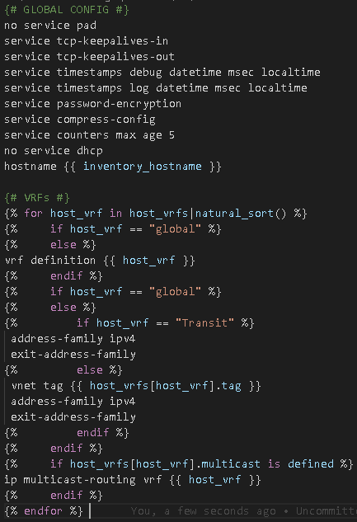
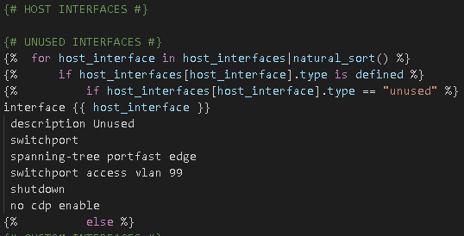
The Automation Progression Pyramid
Templates
For a network device I break down the template into 2 distinct sections: the global config and the interface configs
Global config + VRFs An unused interface
77

Slide 78
The Automation Progression Pyramid
Automated Documentation
Templates are extremely flexible and powerful and you can re-use working logic that generates intended configurations you push to devices in their native syntax (IOS, NXOS, etc) and create automated, source-of-truth, intent-based documentation files
Then inside your Git repo you have version controlled human readable documentation illustrating your intent in CSV, markdown, HTML, mind map, JSON, YAML, or whatever filetype you need!
78

Slide 79
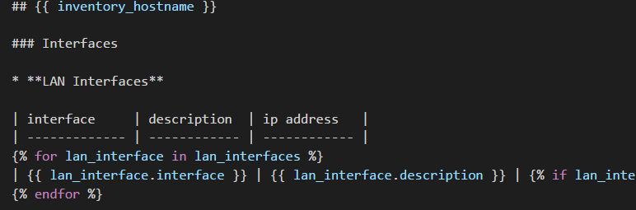
The Automation Progression Pyramid
Templates
A markdown template A CSV template
79

Slide 80
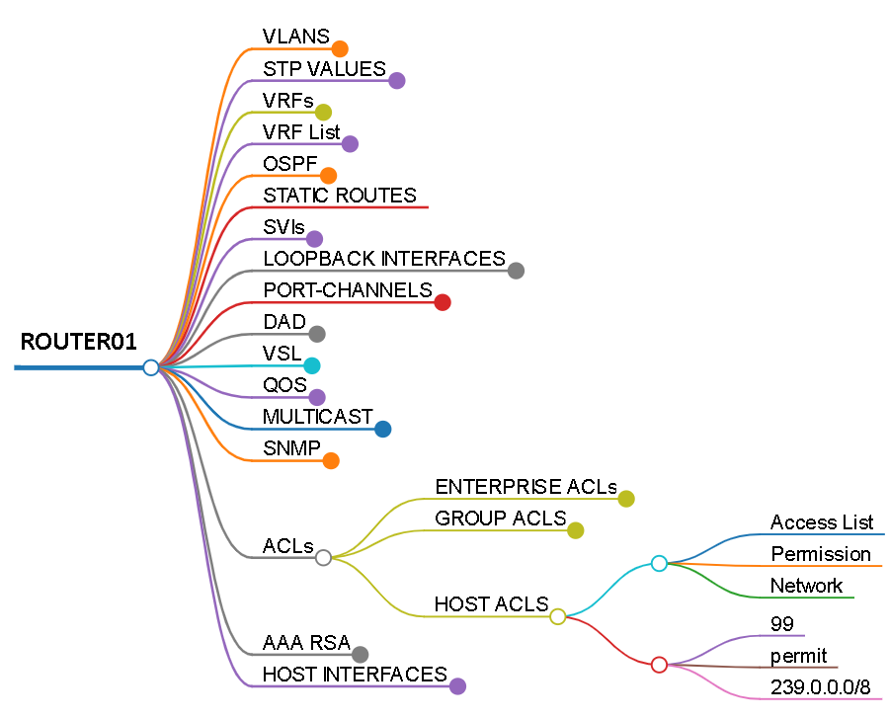
The Automation Progression Pyramid
Templates
From the markdown we can generate a mind map an interactive HTML page
80

Slide 81
The Automation Progression Pyramid
The goal: idempotency
When our intended config and the running-config are idempotent
Ansible will only push changes - - check mode and see if your intent is idempotent
Does the playbook have changes to push ?
(playbook results displayed in yellow at runtime; change = true)
Or is it idempotent?
(results displayed in green; change = false)
81

Slide 82
The Automation Progression Pyramid
The BIG picture
Once you achieve full configuration idempotency – every line, of every device, matching in your Git intent-repository and the running-configuration your main Git branch now represents your entire source of truth and intent
Now you can start to work using Git branches to represent all changes to intent – Moves, Adds, Changes, and Deletions – will all be simple changes to either the data model or template
Nobody is using the CLI anymore !
82

Slide 83
The Automation Progression Pyramid
CI/CD
Full Configuration Management
State Validation
Tactical Changes 1 Time Playbooks
Capture Network State Gather Information
Establish Connectivity
Build Toolkit
State Validation
83

Slide 84
The Automation Progression Pyramid
State Validation
Once you have achieved idempotency and intent for configuration management, arguably the “easy” part, we know the network is configured correctly –
But is it working properly based on our intent ?
84

Slide 85
The Automation Progression Pyramid
Ansible and pyATS
We can go a step further with pyATS which is fully integrated with Ansible to perform network tests from the actual host on the network
This has incredible possibilities and power as you no longer are testing if a third party monitoring tool can reach your device or get SNMP traps or syslog
You take on the persona of the device and test from its CLI
85

Slide 86
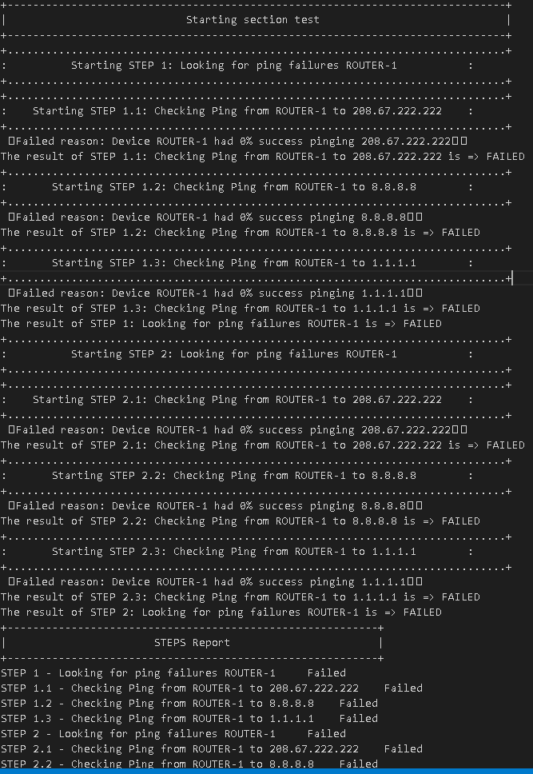
The Automation Progression Pyramid
Ansible and pyATS
86

Slide 87
The Automation Progression Pyramid
CI/CD
Full Configuration Management
State Validation
Tactical Changes 1 Time Playbooks
Capture Network State Gather Information
Establish Connectivity
Build Toolkit
Continuous Integration
Continuous Delivery
87

Slide 88
The Automation Progression Pyramid
Continuous Integration / Continuous Delivery (CI/CD)
The ultimate destination of our automation journey is a complete automation pipeline Continuously integration – ongoing pull requests Continuously delivery - automated builds and releases to the network We have to use our imaginations but it is possibly to create this pipeline | A Git branch is created Clone locally; development occurs Tested and approved to be Pulled into main The successful Pull request triggers an automated pipeline Generate intent and documents Build Docker container image Test the solution against a lab or virtual (vIRL) environment Capture network state Push to environment Validate network state Destroy Docker container image Close or rollback change
88

Slide 89
Recap
In summary…
89

Slide 90
The Automation Progression Pyramid
CI/CD
Full Configuration Management
State Validation
Tactical Changes 1 Time Playbooks
Capture Network State Gather Information
Establish Connectivity
Build Toolkit
90

Slide 91



Thank you
John Capobianco can be reached on Twitter, GitHub, and LinkedIn and would love to connect with you.
twitter.com/John_Capobianco
linkedin.com/in/john-capobianco-644a1515
github.com/automateyournetwork

Slide 92


Thank you
Red Hat is the world’s leading provider of enterprise open source software solutions. Award-winning support, training, and consulting services make
Red Hat a trusted adviser to the Fortune 500.
youtube.com/user/RedHatVideos
linkedin.com/company/Red-Hat
facebook.com/ansibleautomation
twitter.com/ansible

